Slide 1



Workplace Project Breaking Down Silos: Developing a Knowledge Sharing Platform for Internal Business
Callum White – N0897675
Notes:
Hello and welcome to my presentation about my workplace project.

Slide 2




Introduction
Layout:
Benefits of knowledge sharing platform
What currently in the market?
Key features and functionalities
Project outline
Steps to implementation
Best practices and lessons learned
Notes:
Welcome, everyone, to today's presentation on developing a knowledge sharing platform for internal business. In today's fast-paced and rapidly changing business environment, it's more important than ever to break down silos and promote collaboration across teams and departments. By doing so, we can leverage the diverse skills, knowledge, and experience of our employees to drive innovation, solve complex problems, and achieve our business goals.
A knowledge sharing platform can be a powerful tool to facilitate this collaboration and promote the free flow of information and ideas across our organization. In this presentation, we will explore the benefits of developing a knowledge sharing platform, the key features and functionalities to consider, and the steps involved in implementing such a platform. We will also discuss some best practices and lessons learned from other organizations that have successfully implemented knowledge sharing platforms.
Thank you for joining us today, and we hope you find this presentation informative and valuable.

Slide 3
Introduce MHR

Slide 4

Silos and ad-hoc sharing methods are causing issues in the business
Notes:
Our business has separate departments that work in silos, leading to communication barriers and duplication of effort.
Departments often rely on ad-hoc sharing methods like email and messaging, which are informal and can result in useful findings being excluded from certain teams.
This lack of collaboration and information sharing can result in missed opportunities, slower decision-making, and decreased innovation.
Developing a knowledge sharing platform can help us break down these silos and promote better collaboration, allowing us to leverage the diverse skills and expertise of our employees to drive innovation and achieve our business goals.

Slide 5
Opportunity
Way to share knowledge between departments
Reduced duplication of effort
Reduction of silos
of department
Increased collaboration
Notes:
The opportunity to bring in a revolutionary way to share knowledge between departments would be a huge asset to the business. Initial improvements would be seen in the reduced duplication of effort, and as time advances it would encourage the reduction of silos by increased collaboration, sharing of knowledge, and between department idea generation.

Slide 6
Knowledge Sharing Platform for Collaborative Research
Enables real-time communication and knowledge sharing among departments
Reduces duplication of effort and exclusion of departments from useful findings
Departments involved: Product Design, UX, Research, Marketing
Items shared: links, papers, books, videos, summaries, analysis
Current ad-hoc sharing methods: email, Teams, SharePoint, OneDrive, People First communities, Miro
Notes:
Enabling real-time communication and knowledge sharing among departments can help to break down silos and promote better collaboration, leading to increased innovation and efficiency.
A knowledge sharing platform can reduce duplication of effort and help to ensure that all departments have access to useful findings, regardless of their level of involvement in the original research or discovery.
Several departments are involved in the knowledge sharing process, including Product Design, UX, Research, and Marketing, highlighting the cross-functional nature of this initiative.
The types of items shared through the knowledge sharing platform include links, papers, books, videos, summaries, and analysis, representing a diverse range of knowledge sources and formats.
Current ad-hoc sharing methods like email, Teams, SharePoint, OneDrive, People First communities, and Miro can be helpful, but they are not ideal for ensuring that all departments have access to the same information in a timely and efficient manner. A knowledge sharing platform can help to streamline this process and ensure that knowledge is shared more equitably and effectively.

Slide 7


Systems study

Slide 8
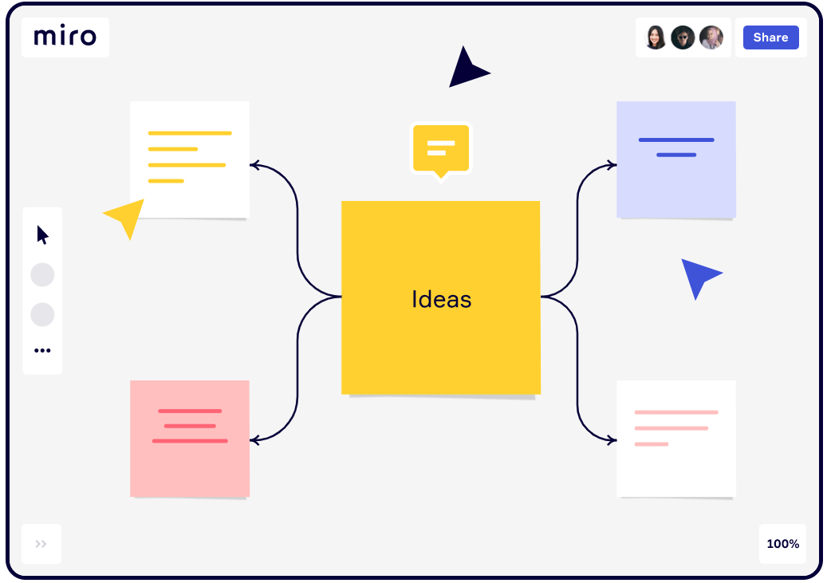
Miro board
Positions itself as a collaborative digital whiteboard that is simple to use. You can arrange objects, make notes, and connect via online chat or embedded videocalls all within the software.
(Innovation training (2021))

Slide 9
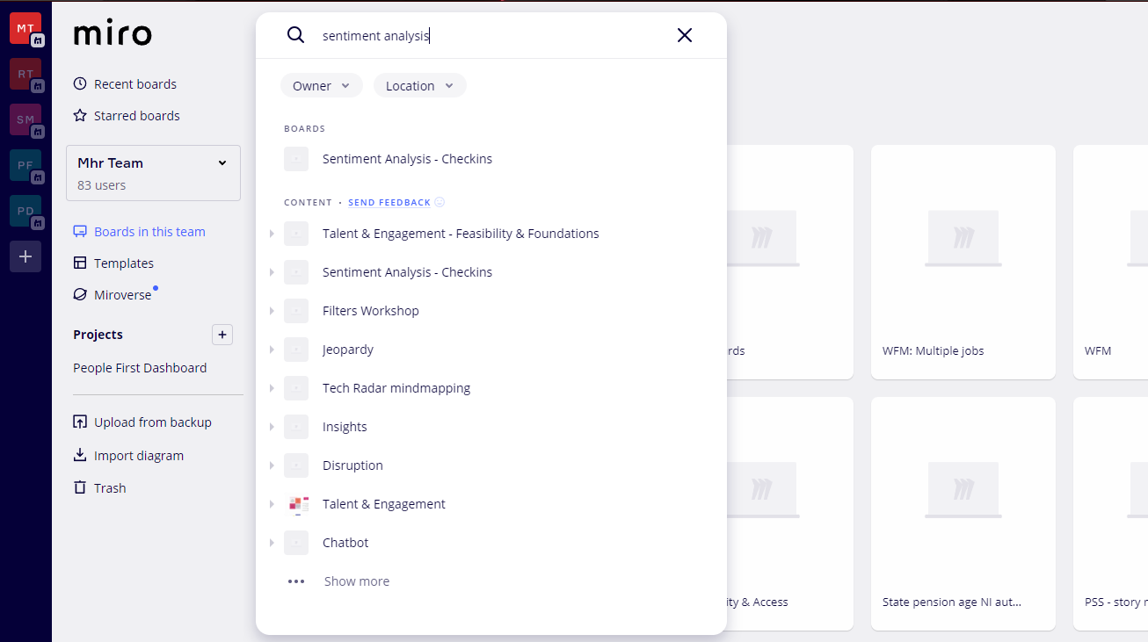
Miro board limitations
External tool – separate to MHR’s infrastructure
Very much a whiteboard online – so they can get unwieldy and hard to go back to
Search multiple boards is limited

Slide 10

Live demo of Miro board
Live demo of Miro board within MHR

Slide 11
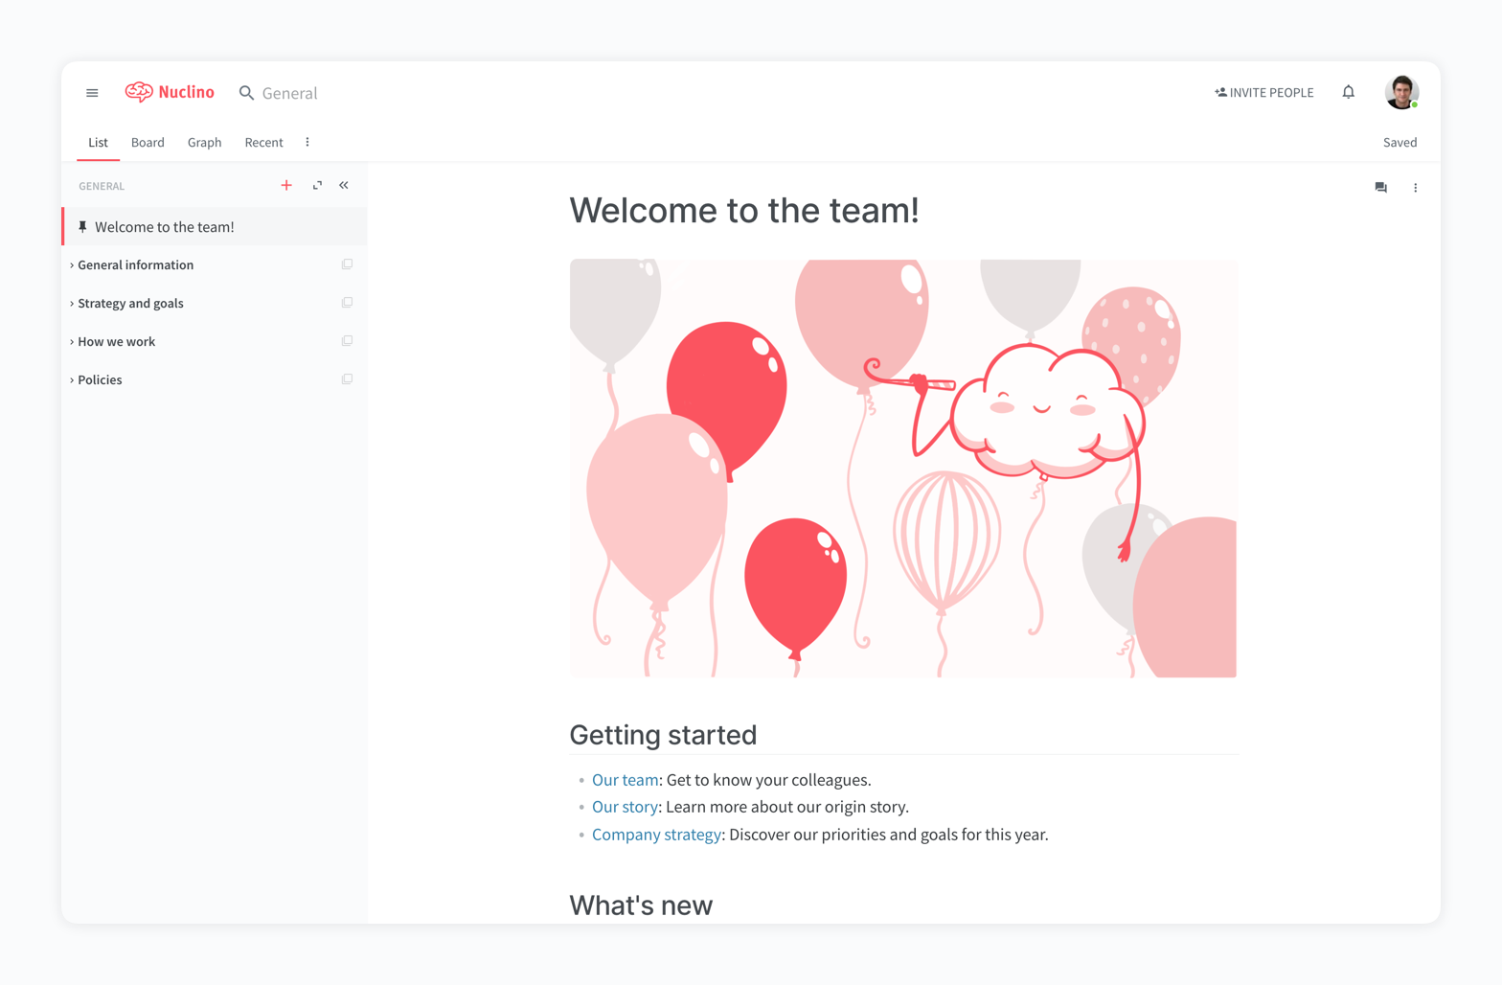
Nuclino
Teams may share and edit documents in real-time with the aid of the knowledge management and collaboration platform Nuclino. Furthermore, the effective search function rapidly displays pertinent results, and the phrases are highlighted in the results, making it simpler to locate desired information (Hero, 2021).
(Marketing tools you can use 2022 (2022))

Slide 12
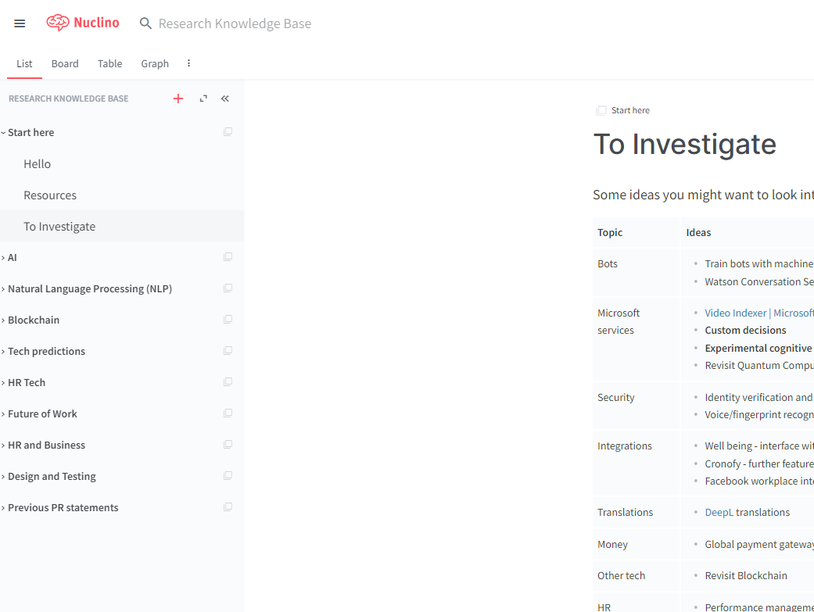
Nuclino limitations
Completely new tool, separate to MHR’s infrastructure.
Content hosted outside of MHR datacentre.
High price for budget

Slide 13
Live demo of Nuclino
Live demo of Miro board within MHR

Slide 14
Results of analysis
Keep the system within MHRs cohesive infrastructure
01
Flexible data structure and searching
02
Within MHRs datacentre
03
Content templating
04

Slide 15
Gap in existing solutions
Existing solutions lack effective search capabilities, resulting in irrelevant keyword-based searches.
This market gap offers an opportunity for knowledge-sharing platforms with graph databases and tagging techniques.
Graph databases enable complex data relationships, suggesting relevant information.
Tagging improves search results, enhances knowledge organization, and supports decision-making.
Notes:
Existing solutions for knowledge repositories often fail to provide effective search capabilities. Keyword-based searches may not always yield relevant results, leaving a gap in the market. Knowledge-sharing platforms that leverage graph databases and tagging techniques can fill this gap and enhance productivity. Graph databases enable complex relationships between data points, allowing the platform to suggest relevant information based on these connections. Additionally, tagging enhances search results by providing more precise categorization of information. Incorporating these features, knowledge-sharing platforms can better support knowledge management and decision-making processes. In summary, the lack of effective search tools in current solutions creates a market opportunity for knowledge-sharing platforms. By utilizing graph databases and tagging techniques, these platforms can improve search effectiveness, facilitate knowledge organization, and enhance decision-making.

Slide 16
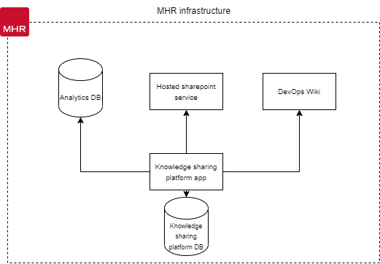
Proposal
The new system will be built in-house, ensuring control over the solution's requirements and features.
Building the system internally enables cohesive services for employees to utilize.
The system will provide a cloud application for employees to manage, tag, and search for content.
Notes:
This new system will be built inhouse, allowing for controlled outcomes of the solution’s requirements and features. This will also enable cohesive services for employees to use and provide a cloud application allowing employees to manage, tag, and search for content.

Slide 17

Challenges
People don’t share new knowledge: The repository needs to be added to regularly to ensure knowledge doesn’t stay in personal notes, OneDrive documents or within teams, therefore it needs to be accessible and easy to use.
People can’t find knowledge: The tool needs to have a good mechanism for searching so that discoverability of current knowledge is easy.
Knowledge needs to stay in-house: The tool needs to have secure access for MHR internal employees only (e.g. use of single sign on).
People will want the solution to fulfil other requirements: When creating the solution, ensure that it doesn’t try to fulfil too wide a scope – first and foremost it is an easy-to-use repository of knowledge for MHR.
Notes:
People don’t share new knowledge: The repository needs to be added to regularly to ensure knowledge doesn’t stay in personal notes, OneDrive documents or within teams, therefore it needs to be accessible and easy to use.
People can’t find knowledge: The tool needs to have a good mechanism for searching so that discoverability of current knowledge is easy.
Knowledge needs to stay in-house: The tool needs to have secure access for MHR internal employees only (e.g. use of single sign on).
People will want the solution to fulfil other requirements: When creating the solution, ensure that it doesn’t try to fulfil too wide a scope – first and foremost it is an easy-to-use repository of knowledge for MHR.

Slide 18

Professional Issues Integrating BCS Code of Conduct
Curate platform content to align with BCS ethical standards
Emphasize privacy, security, and well-being
Guide employees in respecting legal rights and unbiased behaviour
Promote equal access to IT benefits
Cultivate a culture of responsible software development and ethical business practices
Notes:
Business Content Focus: The system will only provide business or business skill-related information for upskilling and employee training. Non-business content is not desired as the tool is meant for internal use.
BCS (Code of Conduct): Software Developers must follow a code of ethics and guidelines when creating and maintaining software. Examples from the BCS Code of Conduct include:
Respecting the environment, privacy, security, and public health.
Honoring the legal rights of others.
Performing professional duties without prejudice based on personal characteristics.
Promoting equal access to IT advantages and encouraging participation from all societal segments.
Integrating BCS Code of Conduct: To incorporate the BCS Code of Conduct into our knowledge-sharing platform, we will curate content that aligns with ethical standards. This includes selecting materials that prioritize privacy, security, and well-being. The platform will provide guidance on respecting legal rights and promoting unbiased professional behavior. It will also foster equal access to IT benefits and encourage participation from all groups.
Promoting Responsible Software Development: By incorporating these principles into our platform's content and making them easily accessible, we can cultivate a culture of responsible software development and ethical business practices within our company.

Slide 19

Ethical Issues Preventing Unethical Practices
Commenting for Relative Feed (Gamification)
Users attempting to force comments on their posts for promotion is unethical
Exploitation of the comment system for gamification should be avoided
Commenting will have no impact on the post order in the user's feed
Plagiarism
Sharing content feature can be abused for plagiarism
Plagiarism is unethical and undermines the original author's credit
Content Admins will verify knowledge content across the system
Consider implementing a 'Turnitin'-like software for automated content checking
Note: Content Admins and automated content checking will help ensure ethical practices and maintain the integrity of the platform.

Slide 20

Legal Issues Licensing, Intellectual Property, Data Ownership, and Source Control
Licensing
Internal use of the project does not require licensing
Transition to customer consumption would necessitate licensing
Software license defines creator and user rights, usage restrictions, and payment details
Consider using an MIT license if the project becomes open source
Intellectual Property of Content
Sharing intellectual property poses risks
Violation of patents, trademarks, copyrights, trade secrets, or trade dress can lead to takedown and damages
Precautions: Employees should reference external sources for shared knowledge
Data Ownership
GDPR Act applies to data collection and storage
Adhere to regulations and store/handle essential data only
Non-compliance may result in fines and negative company reputation
Source Control
Code stored in Azure DevOps with restricted access for verified business personnel
External individuals do not have read/write access
Protects intellectual property of the product and ensures code security

Slide 21

Social Issues Free Text Content and Content Sharing
Free Text Content
Users can share free text content as a product feature
Misuse may lead to insensitive texts and offensive content
Potential for social issues within the business
Content admins will review and remove inappropriate content
Company policies guard against social issues in software communication and interaction
Content Sharing
Users can share external content within the system
Inappropriate work content may cause offense and social issues
Admins maintain a list of verified domains
Users can only share information from these trusted domains
Prevents sharing of inappropriate content and promotes responsible content sharing

Slide 22

Project management

Slide 23
Objectives
Foster
Foster active engagement and collaboration among employees through a user-friendly platform.
Cultivate
Cultivate transparency and knowledge sharing by facilitating easy access to relevant information and resources.
Break down
Break down departmental barriers and encourage cross-functional collaboration via a centralized knowledge-sharing hub.
Enhance
Enhance internal communication efficiency with real-time feedback and discussion capabilities.
Boost
Boost productivity by providing employees access to a diverse range of resources and expertise.
Ensure
Ensure platform security and compliance with data privacy regulations.
Integrate
Seamlessly integrate the platform with existing systems and workflows.
Enable
Enable administrators to track user engagement and content performance through analytics and reporting features.

Slide 24
Functional Requirements
Requirement | Type
Integrate with Active Directory for SSO | System process
Grant varying levels of authorization to different user types | System process
Allow users to create and publish articles, free form content, and books | System process
Enable admins to manage content by reviewing and approving posts, removing outdated or irrelevant content | System process
Implement a robust tagging system for users to categorize their posts with relevant keywords | System process
Include a powerful search function for users to easily find content based on specific keywords or categories | System process
Encourage user engagement through features like commenting and rating | System process
Enable users to connect with others who share similar interests or expertise | System process
Provide analytics and reporting features for tracking user engagement and content performance | System process
Allow admins to export data for further analysis | System process
Ensure platform security and compliance with relevant data privacy regulations | System process
Implement features like encryption, user access controls, and data retention policies | System process
Integrate with company's internal communication and project management systems | System process

Slide 25
Non-Functional Requirements
Requirement | Type
Handle a large volume of users and content without significant degradation in performance | Performance
Ensure the platform is responsive and loads quickly | Performance
Make the platform easy to use and navigate | Usability
Provide user-friendly interfaces for content creation and management | Usability
Ensure the platform is always available and accessible to users | Reliability
Include backup and disaster recovery mechanisms to maintain data integrity | Reliability
Ensure the platform is compatible with a variety of devices and browsers | Compatibility
Comply with relevant web standards and protocols | Compatibility

Slide 26

Project scope
Phase 1
Cloud-based central knowledge platform.
The central repository will allow users to manage, feedback and share content between employees of MHR.
Provide simplistic searching capabilities with content templating.

Slide 27
Project timeline
Development completed
Publish to userbase
Jan 2023
Analysis/Software Requirements
Feb 2023
Foundation scope 1
DevOps & Environment Development Setup
March 2023
Development -
Timebox 1 & 2 begins
April 2023
Development – Timebox 1 & 2 completed
May/June 2023
Timebox 3 begins

Slide 28
Success Criteria
Increased User Engagement
Measure: Active users, interactions, user satisfaction
Objective: Boost user engagement
Improved Knowledge Sharing
Measure: Posts, interaction quality
Objective: Enhance knowledge sharing
Reduced Silos
Measure: Cross-functional collaboration, info sharing
Objective: Break down departmental barriers
Efficient Administration
Measure: User management, moderation, analysis
Objective: Streamline administration
Effective Recommendations
Measure: Relevant, useful posts and engagement
Objective: Provide valuable recommendations
Secure and Reliable
Measure: Security, uptime, user trust
Objective: Ensure platform reliability
Scalable
Measure: Handling growth, performance
Objective: Support future demands

Slide 29

System design

Slide 30
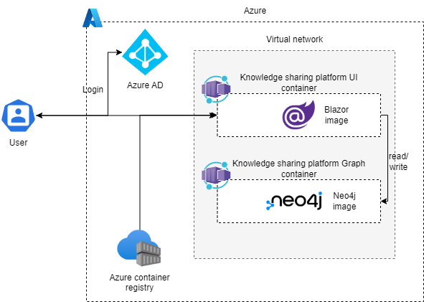
Architecture Diagram
Using Azure as the cloud provider.
Azure AD for SSO
Azure container registries for

Slide 31
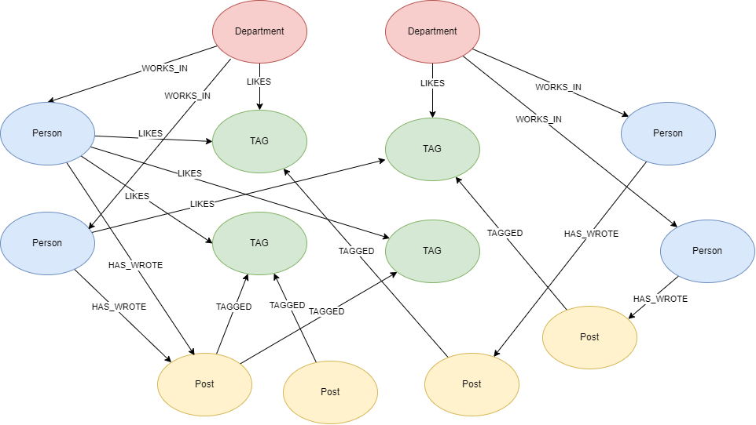
Graph database design
Department
name: a string representing the name of the department.
description: a string representing a description of the department.
location: a string representing the location of the department.
Person
name: a string representing the name of the person.
age: an integer representing the age of the person.
email: a string representing the email address of the person.
Post
title: a string representing the title of the post.
body: a string representing the body of the post.
timestamp: a datetime object representing the time when the post was created.
type: a string which represents the type of post.
Tag
name: a string representing the name of the tag.
description: a string representing a description of the tag.

Slide 32
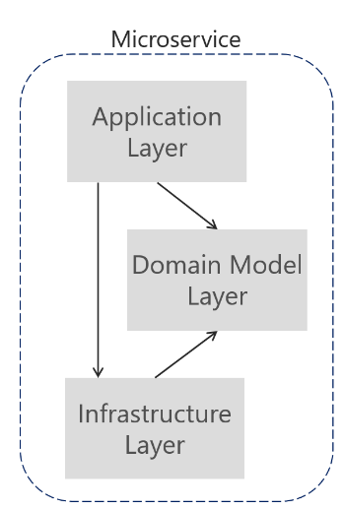
Layed architecture
Separation of concerns:
Focused layers for easier maintenance, cleanliness, and understanding
Role-specific modifications within each layer
Flexibility:
Independent layers for making changes without impacting others
Prevention of bugs and issues during layer modifications
Reusability:
Layers can be utilized by other applications with similar concerns and functionality
Increased testability:
Independent testing of each layer
Smaller, specific tests for individual application components
Notes:
Separation of concerns ensures focused layers, facilitating codebase maintenance, cleanliness, understandability, and role-specific modifications. Independence among layers enables flexibility, preventing bugs and issues when making changes to one layer without affecting others. Layers can be reused by other applications with similar concerns and functionality. Individual testing of each layer enhances testability, allowing smaller, specific tests to be written for each application component.

Slide 33
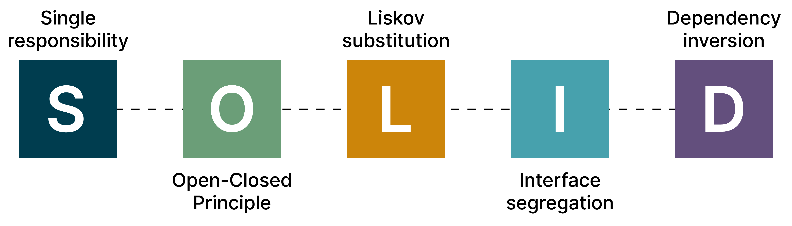
Coding standard Five Essential Design Principles (SOLID)
Single Responsibility Principle (SRP)
Each class, module, or function should have a single responsibility.
Promotes better organization and maintainability.
Open Closed Principle (OCP)
Classes should be open to extension but closed to modification.
Enables flexibility and avoids code changes in existing classes.
Liskov Substitution Principle (LSP)
Subclasses should be interchangeable with their base classes.
Ensures substitutability and adherence to the expected behaviour.
Interface Segregation Principle (ISP)
Interfaces should be separated and focused on specific responsibilities.
Prevents clients from depending on unnecessary methods
Dependency Inversion Principle (DIP)
Interfaces should be separated and focused on specific responsibilities.
Prevents clients from depending on unnecessary methods
Notes:
Separation of concerns ensures focused layers, facilitating codebase maintenance, cleanliness, understandability, and role-specific modifications. Independence among layers enables flexibility, preventing bugs and issues when making changes to one layer without affecting others. Layers can be reused by other applications with similar concerns and functionality. Individual testing of each layer enhances testability, allowing smaller, specific tests to be written for each application component.

Slide 34
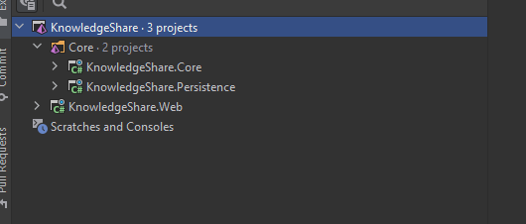

.NET application demonstration
Layered architecture
Notes:
Creating a .NET project with a layered architecture consisting of KnowledgeShare.Web, KnowledgeShare.Core, and KnowledgeShare.Persistence is a good design because it promotes separation of concerns, improves maintainability, and enhances testability of the application.

Slide 35
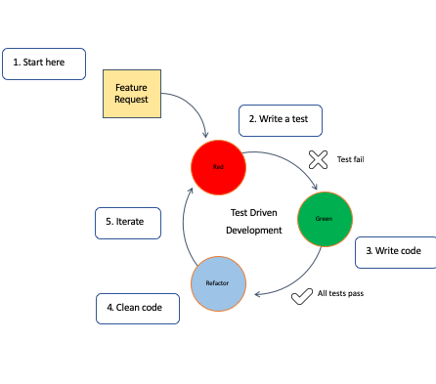
Test driven development
Understand requirements and write test case.
Write test from test case and run test so it fails.
Write implementation of functionality and rerun to test to pass.
Refactor code.
Repeat process for any

Slide 36
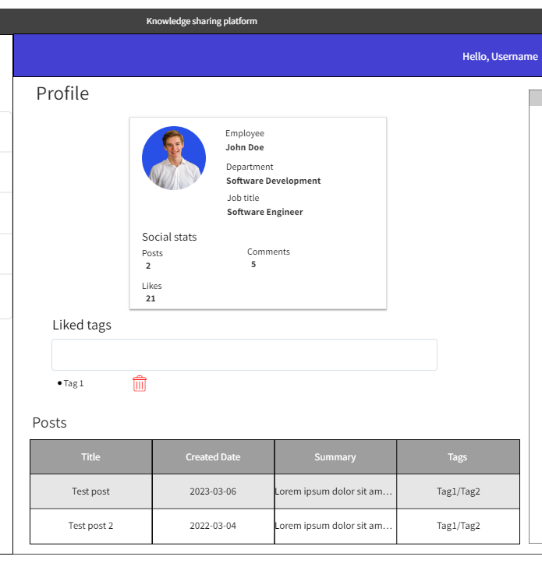
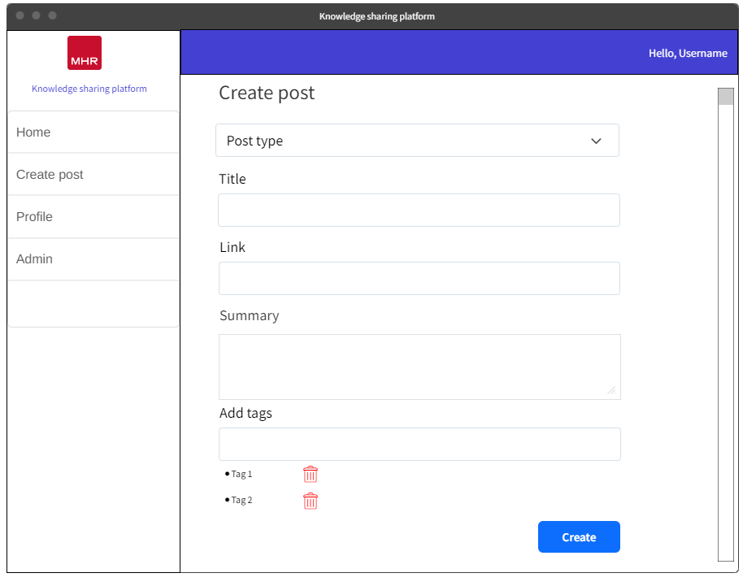
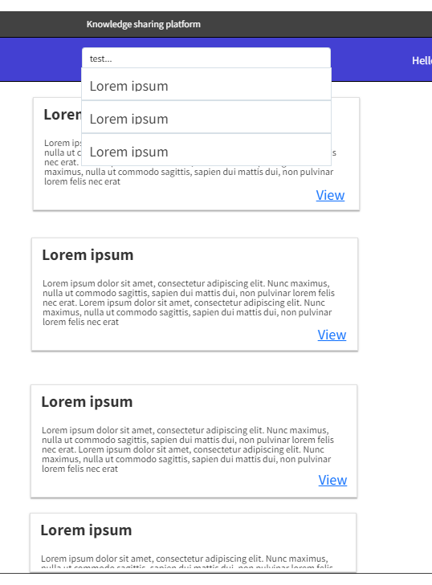
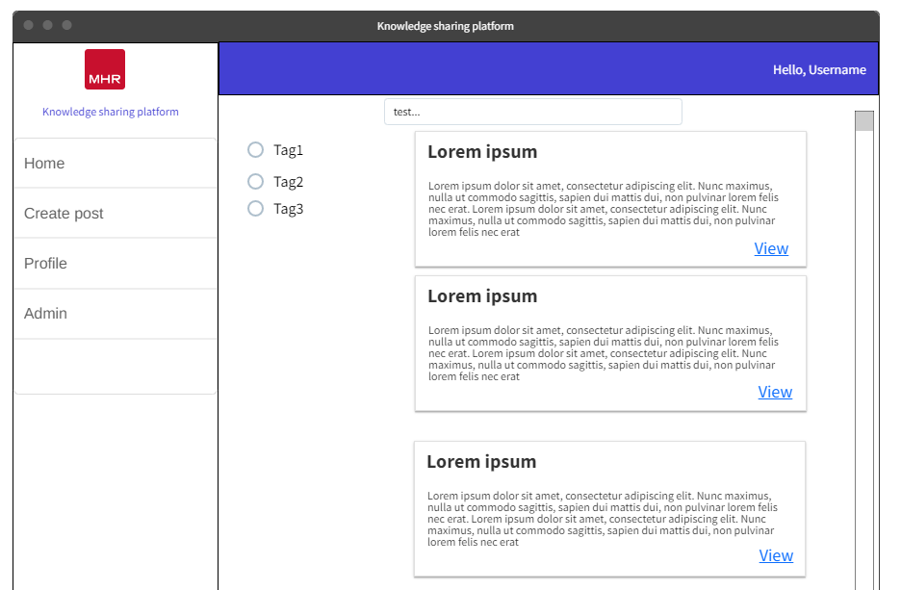
UX Designs
Wireframes were created for the UI.
These were then reviewed and had feedback from stakeholders in the project.

Slide 37

Iterative development
Break down of each sprint and what was done

Slide 38
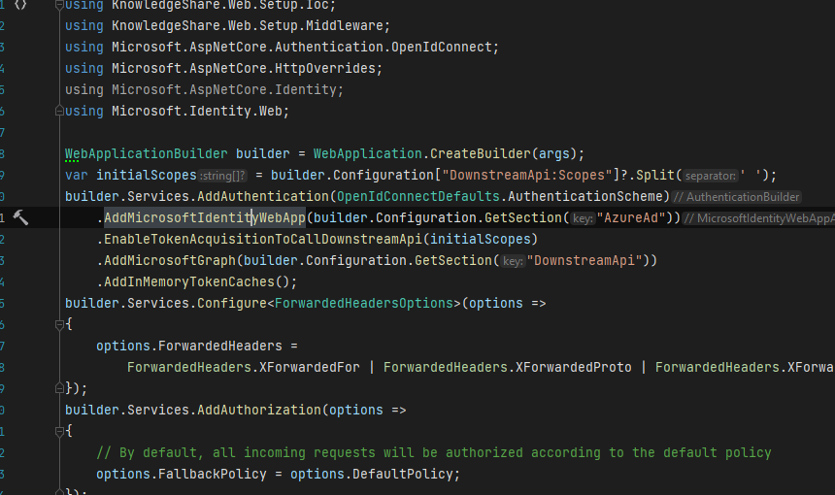
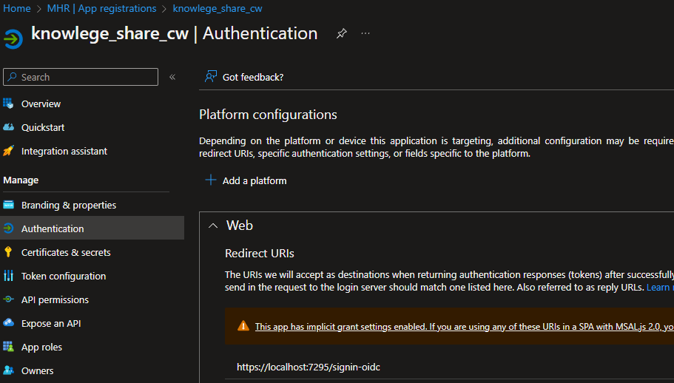
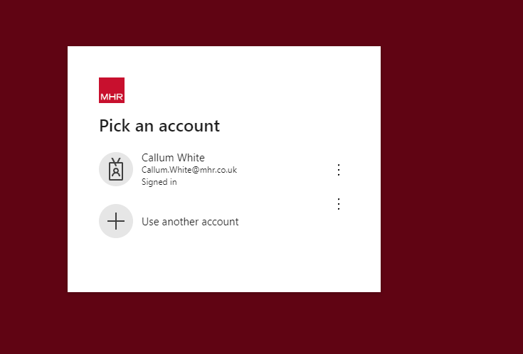
Sprint 1
Single sign on setup
Create app registration in Azure & provide the redirect URL
Setup authentication in .NET application startup project

Slide 39
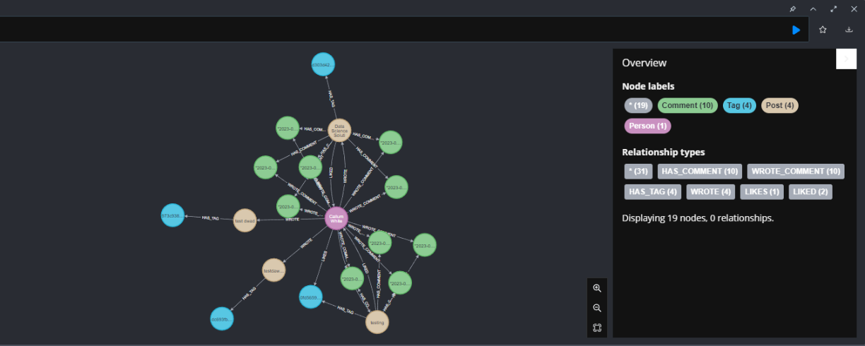
Sprint 1
The challenge in developing the graph database was configuring persistence layer for Neo4j. Setup involved installing Neo4j, establishing connection, and utilizing .NET driver.
Shows a graph of the data model within Neo4j database, this uses bloom that allows for queries to be directly ran on the database and shown visually
Notes:
The initial challenge in developing the graph database was configuring the application's persistence layer to interface with a Neo4j database. This involved installing Neo4j on the local machine and ensuring that the connection between the database and .NET application was properly established.
To set up the Neo4j driver in .NET, the team utilized NuGet to install the Neo4j .NET driver package to the .NET application. Additionally, they installed Neo4j Desktop to enable local database instance management and establish a connection to the database in their .NET application using the driver, specifying server address, port, and credentials.

Slide 40
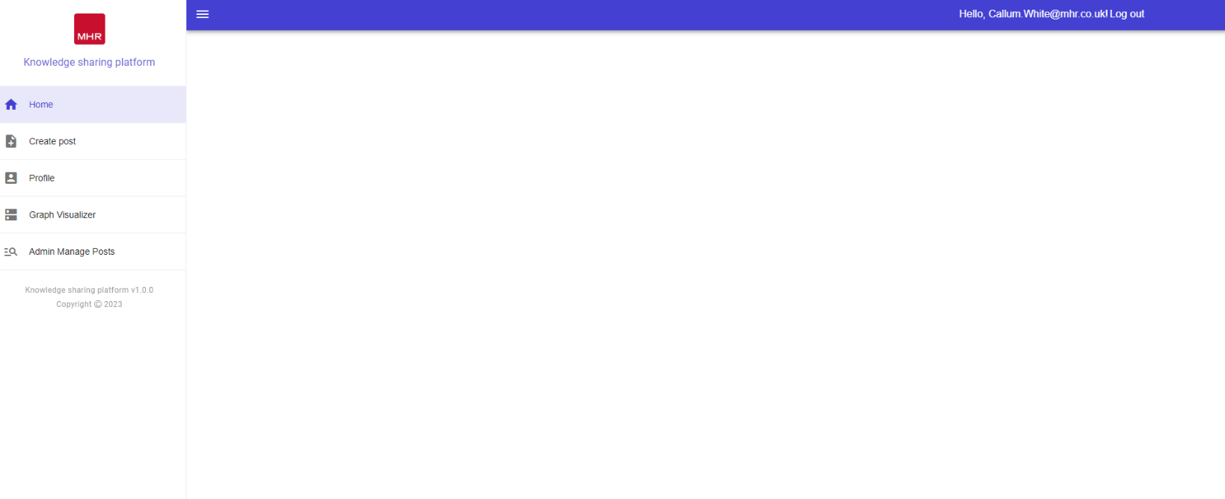
Sprint 2
Landing Page Overview:
Design a comprehensive landing page showcasing the application's functionality.
Incorporate interactive elements, like buttons and forms, for an engaging and user-friendly experience.
User Feedback and Implementation:
Incorporate user's full name instead of email as the username in the top right corner of the page, based on project sponsor feedback.
Utilize Microsoft Graph API to retrieve user information, including first and last name.
Challenges and Optimization:
Ensure landing page responsiveness and compatibility across various devices and browsers.
Optimize page performance to minimize load times and enhance overall user experience.

Slide 41
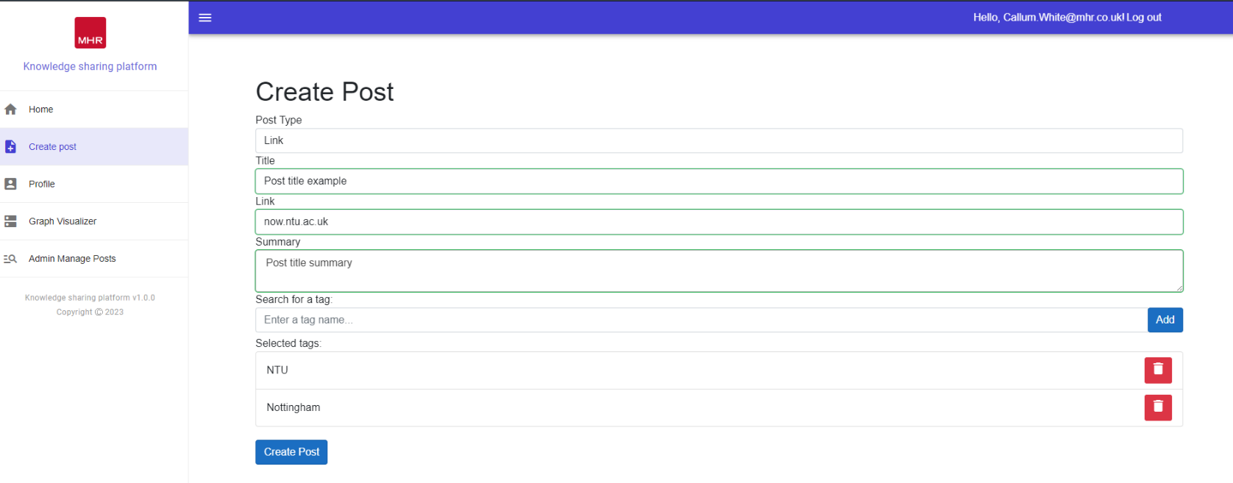
Sprint 2
Creating Post User Interface:
Design an intuitive and easy-to-navigate user interface for creating posts.
Implement the interface using the Blazor framework.
Post Creation Options:
Enable users to select the type of post they want to create (link, book, or free-form).
Collect necessary information based on the selected post type, such as title, summary, and URL for links and books, and free-form text for free-form posts.
Allow users to add tags to their posts.
Challenges with Blazor Implementation:
Overcome challenges related to form submissions, validations, and proper functioning.
Invest time in resolving issues to ensure correct form behavior.
User Interface with Tagging:
Incorporate a dynamic input box for users to add tags to their posts.
Provide functionality for users to delete tags from their posts.

Slide 42
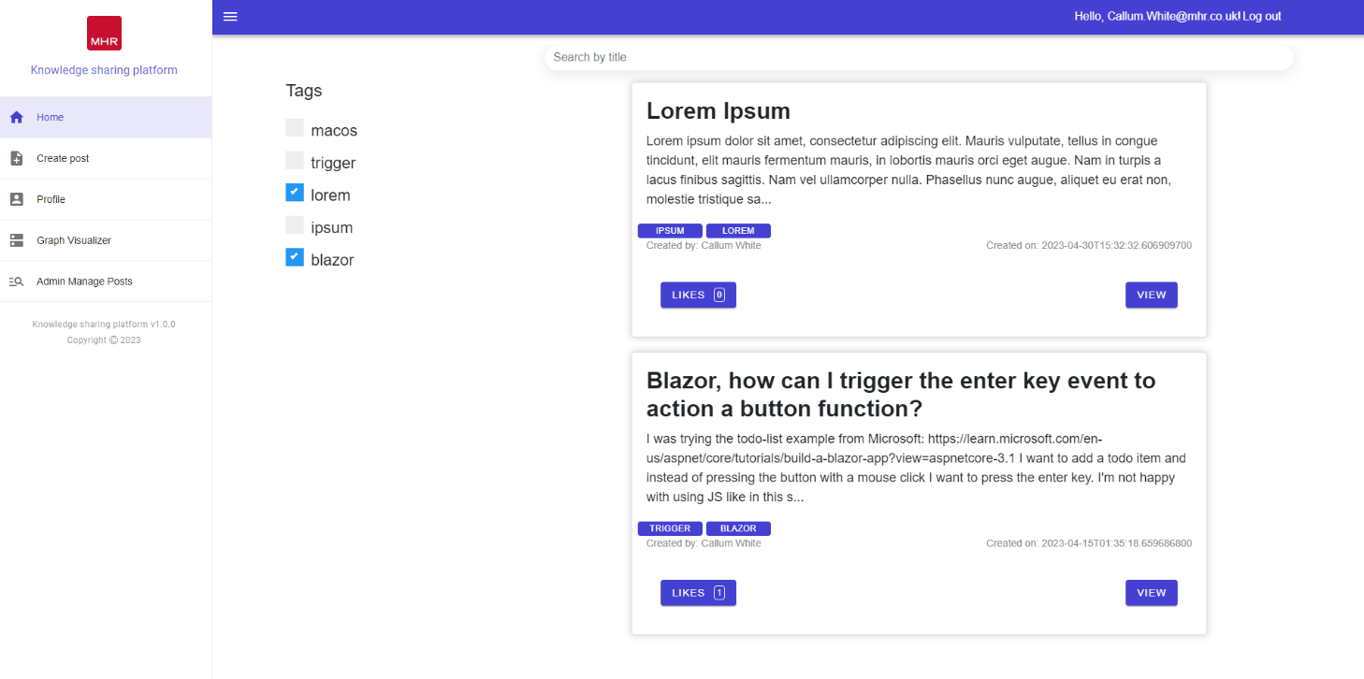
Sprint 2
Discovery

Slide 43
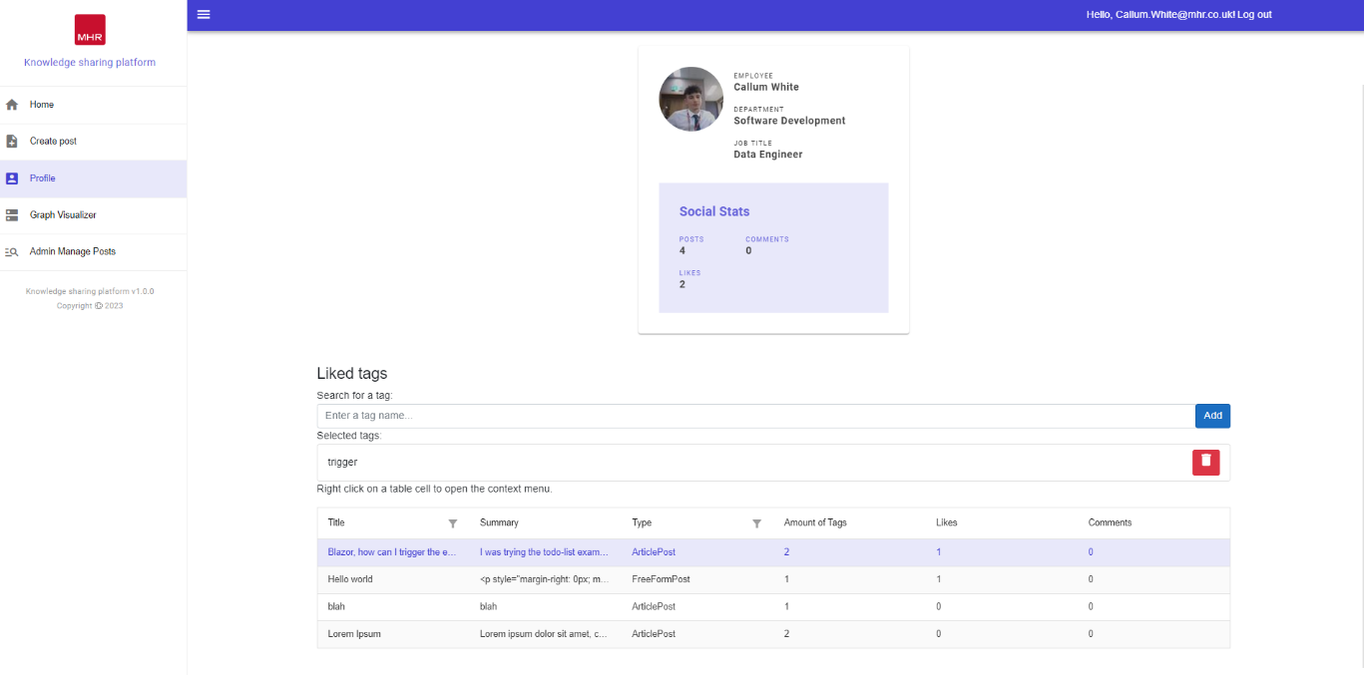
Sprint 3
Profile page

Slide 44
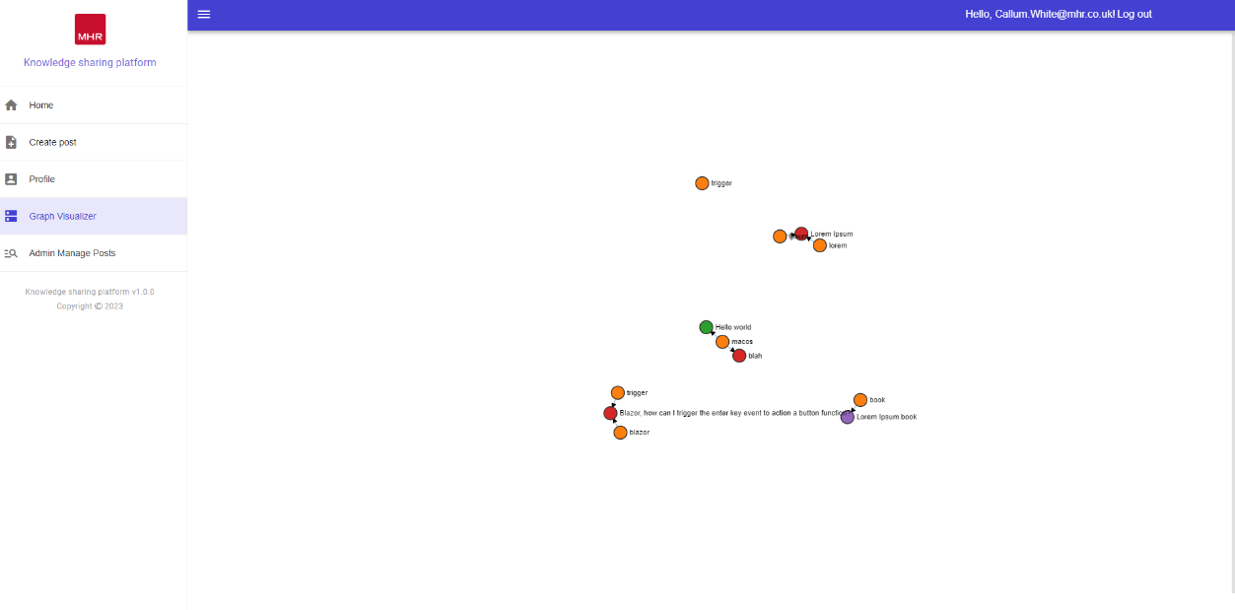
Sprint 3
Profile page

Slide 45
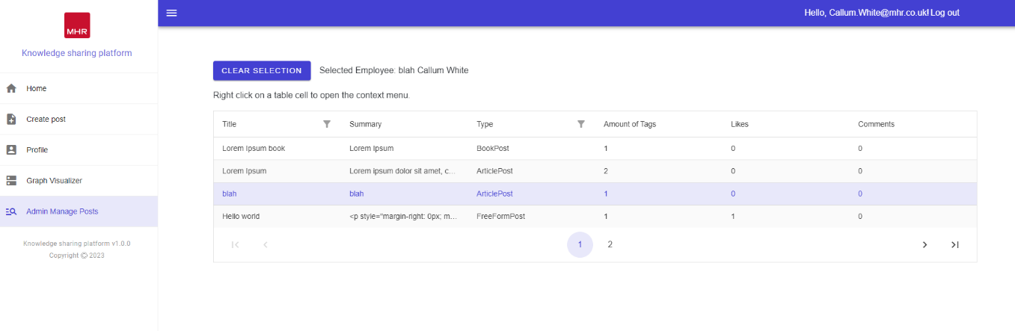
Sprint 3
Admin page

Slide 46
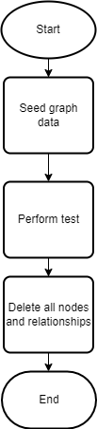
Unit & Integration test
Integration Testing Setup:
Separate Neo4j database created for testing
Does not impact the current Dev database for development purposes
Integration Testing Process:
Utilizes NUnit framework
Teardown functionality clears down Neo4j graph database after each test
Ensures idempotent tests that can be repeated multiple times within a session
Maintains test consistency

Slide 47
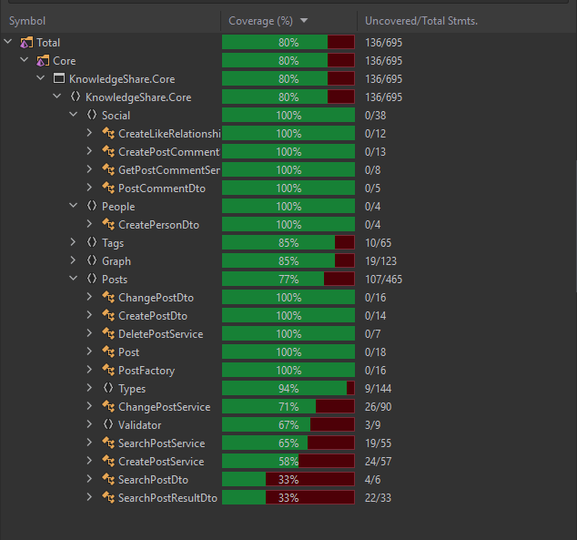
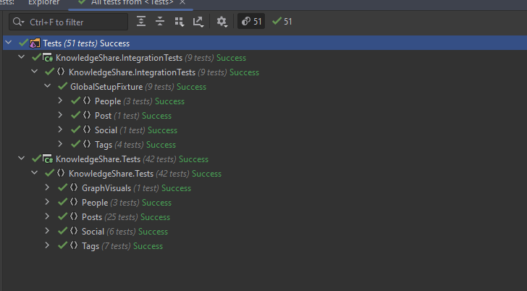
Unit & Integration test results

Slide 48
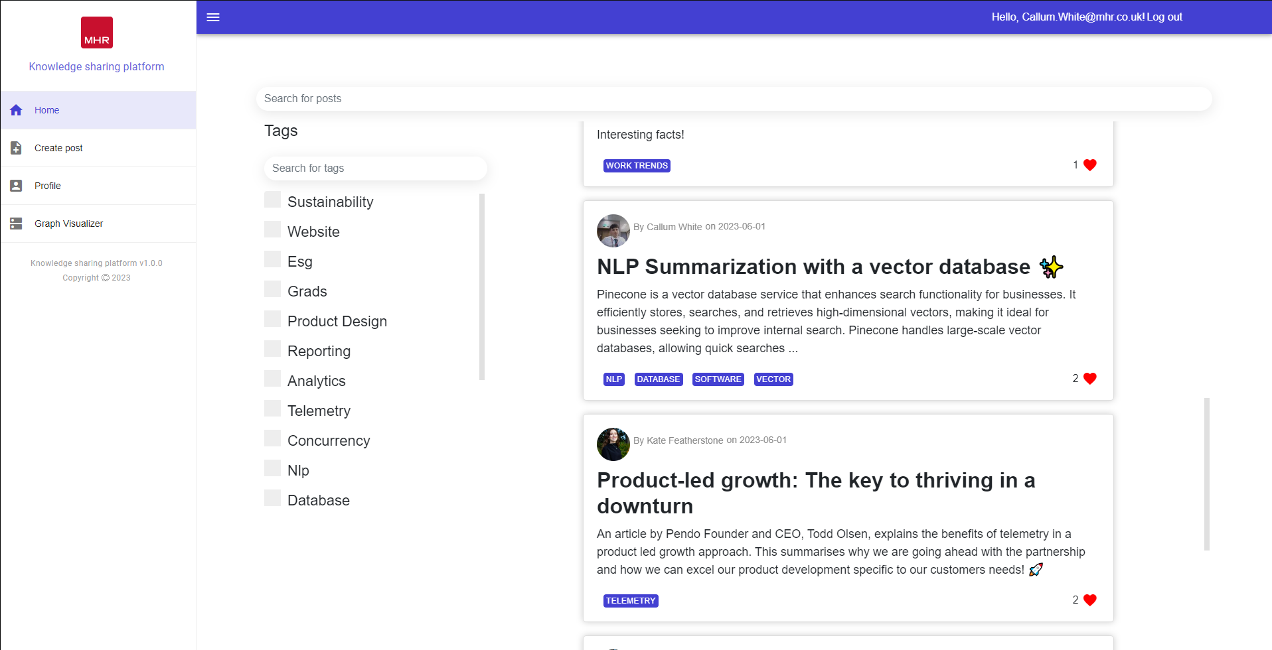
Live Demo of Knowledge sharing platform
Kate will be helping with the Demo

Slide 49
UI Feedback
User experience (UX) feedback must be incorporated into the knowledge sharing platform's iterative development process to improve the platform's usability and aesthetic appeal.
Notes:
User experience (UX) feedback must be incorporated into the knowledge sharing platform's iterative development process to improve the platform's usability and aesthetic appeal. In this review, a UX specialist within in the business offers insightful commentary on the platform's various pages' CSS styling. Their suggestions centre on maximising screen space, achieving visual harmony, upholding consistency, and enhancing user experience overall.

Slide 50
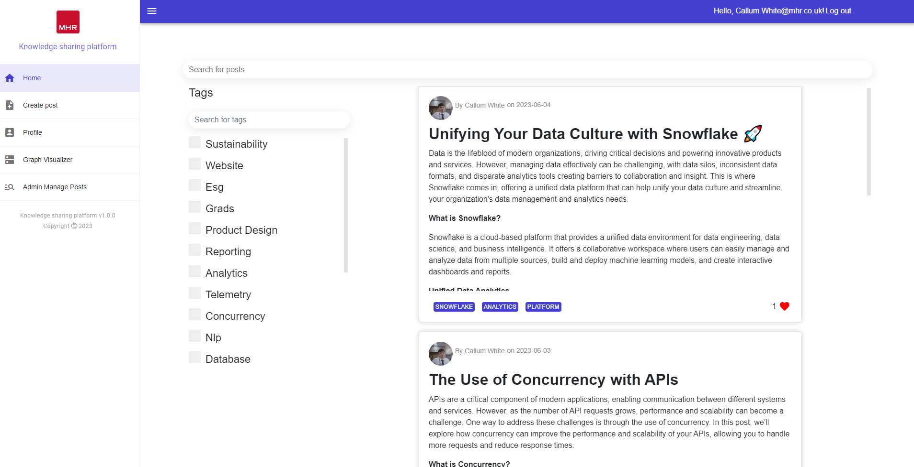
Discovery page
Notes:
Padding Reduction at the Bottom of Cards: To optimize screen real estate and achieve a more visually balanced layout, it is recommended to decrease the padding between the content of the cards and the bottom edge. This adjustment will create a more compact design while maintaining the necessary breathing space.
Background Removal and Lowercasing of "Likes": To maintain a consistent and modern typographic style, our UX expert suggests removing any background element behind the likes count on the cards. Additionally, they recommend using lowercase letters for the word "likes." These changes will contribute to a cleaner and more streamlined appearance.
Alignment of Likes with Info Detail: To enhance the visual hierarchy and overall alignment, aligning the likes count with the accompanying information details on the cards is advised. This adjustment will result in a more organized and visually pleasing layout, improving the overall user experience.
Removal of "View" Button for Post Access: To simplify the user interface and streamline the navigation, our UX expert proposes removing the "View" button that allows users to access the full post from the discovery page. Instead, it is suggested to make the entire card clickable, enabling users to navigate to the post by clicking anywhere on the card.
Use of Light Grey Colours for Tags: For an aesthetically pleasing design and reduced visual distractions, our colleague suggests utilizing light grey colours for the tags on the discovery page, replacing the current blue. This adjustment will create a more subdued and harmonious colour palette, allowing the primary content to stand out effectively.

Slide 51
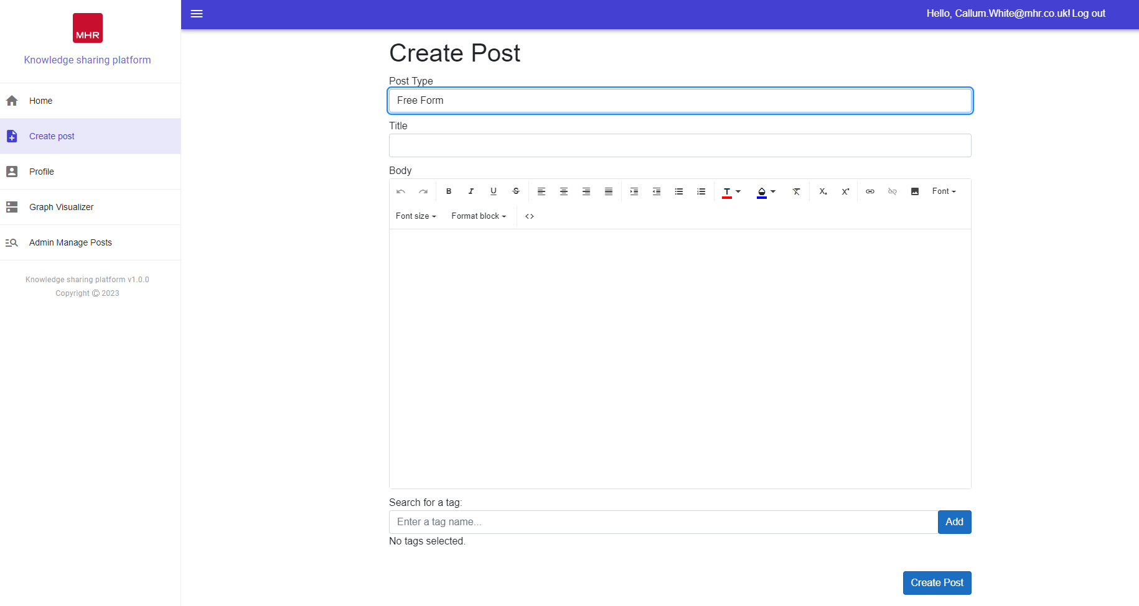
Create post page
Notes:
Padding Reduction at the Bottom of Cards: To optimize screen real estate and achieve a more visually balanced layout, it is recommended to decrease the padding between the content of the cards and the bottom edge. This adjustment will create a more compact design while maintaining the necessary breathing space.
Background Removal and Lowercasing of "Likes": To maintain a consistent and modern typographic style, our UX expert suggests removing any background element behind the likes count on the cards. Additionally, they recommend using lowercase letters for the word "likes." These changes will contribute to a cleaner and more streamlined appearance.
Alignment of Likes with Info Detail: To enhance the visual hierarchy and overall alignment, aligning the likes count with the accompanying information details on the cards is advised. This adjustment will result in a more organized and visually pleasing layout, improving the overall user experience.
Removal of "View" Button for Post Access: To simplify the user interface and streamline the navigation, our UX expert proposes removing the "View" button that allows users to access the full post from the discovery page. Instead, it is suggested to make the entire card clickable, enabling users to navigate to the post by clicking anywhere on the card.
Use of Light Grey Colours for Tags: For an aesthetically pleasing design and reduced visual distractions, our colleague suggests utilizing light grey colours for the tags on the discovery page, replacing the current blue. This adjustment will create a more subdued and harmonious colour palette, allowing the primary content to stand out effectively.

Slide 52
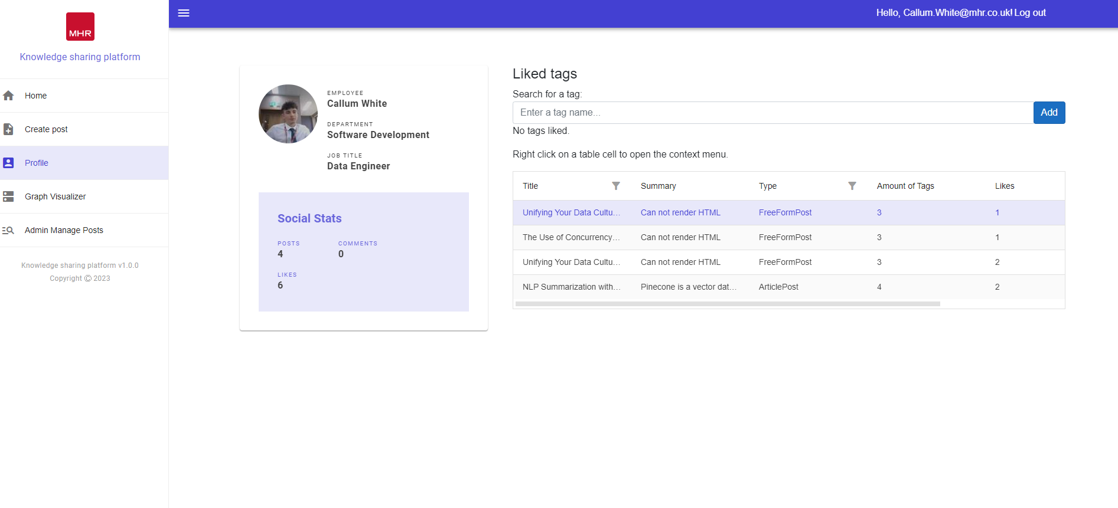
Profile page
Notes:
Padding Reduction at the Bottom of Cards: To optimize screen real estate and achieve a more visually balanced layout, it is recommended to decrease the padding between the content of the cards and the bottom edge. This adjustment will create a more compact design while maintaining the necessary breathing space.
Background Removal and Lowercasing of "Likes": To maintain a consistent and modern typographic style, our UX expert suggests removing any background element behind the likes count on the cards. Additionally, they recommend using lowercase letters for the word "likes." These changes will contribute to a cleaner and more streamlined appearance.
Alignment of Likes with Info Detail: To enhance the visual hierarchy and overall alignment, aligning the likes count with the accompanying information details on the cards is advised. This adjustment will result in a more organized and visually pleasing layout, improving the overall user experience.
Removal of "View" Button for Post Access: To simplify the user interface and streamline the navigation, our UX expert proposes removing the "View" button that allows users to access the full post from the discovery page. Instead, it is suggested to make the entire card clickable, enabling users to navigate to the post by clicking anywhere on the card.
Use of Light Grey Colours for Tags: For an aesthetically pleasing design and reduced visual distractions, our colleague suggests utilizing light grey colours for the tags on the discovery page, replacing the current blue. This adjustment will create a more subdued and harmonious colour palette, allowing the primary content to stand out effectively.

Slide 53
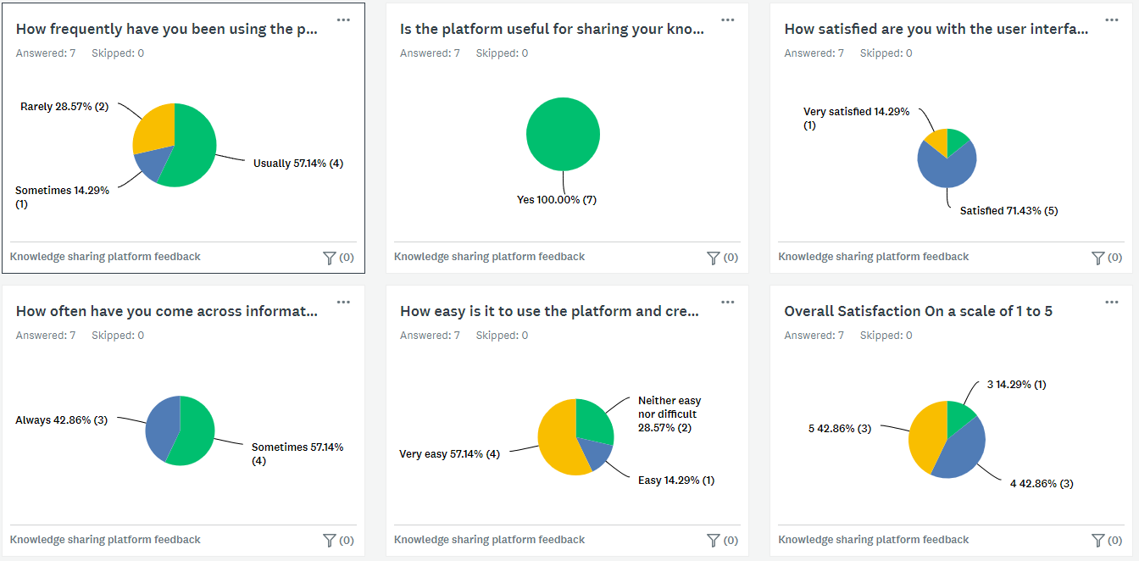
Knowledge sharing feedback
Notes:
Padding Reduction at the Bottom of Cards: To optimize screen real estate and achieve a more visually balanced layout, it is recommended to decrease the padding between the content of the cards and the bottom edge. This adjustment will create a more compact design while maintaining the necessary breathing space.
Background Removal and Lowercasing of "Likes": To maintain a consistent and modern typographic style, our UX expert suggests removing any background element behind the likes count on the cards. Additionally, they recommend using lowercase letters for the word "likes." These changes will contribute to a cleaner and more streamlined appearance.
Alignment of Likes with Info Detail: To enhance the visual hierarchy and overall alignment, aligning the likes count with the accompanying information details on the cards is advised. This adjustment will result in a more organized and visually pleasing layout, improving the overall user experience.
Removal of "View" Button for Post Access: To simplify the user interface and streamline the navigation, our UX expert proposes removing the "View" button that allows users to access the full post from the discovery page. Instead, it is suggested to make the entire card clickable, enabling users to navigate to the post by clicking anywhere on the card.
Use of Light Grey Colours for Tags: For an aesthetically pleasing design and reduced visual distractions, our colleague suggests utilizing light grey colours for the tags on the discovery page, replacing the current blue. This adjustment will create a more subdued and harmonious colour palette, allowing the primary content to stand out effectively.

Slide 54
Thank you

Slide 55
Q&A

